Slide 1

WEB SCRAPING AND SENTIMENT ANALYSIS

Slide 2
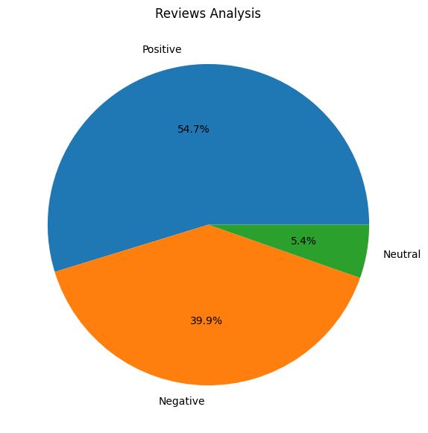
VISUALIZATION
Upon extracting and pre-processing 3500 reviews.
We got to know that
54.7% reviews are positive
5.4 % reviews are neutral
39.9% reviews are negative

